Slide 1
Jan 6th Agenda
Recap what happened last time (slide 2, 5 min)
Current plots and GSM8K inclusion / Exclusion (slide 3-10, 20 min)
Are the current plots sufficient?
Is GSM8K negative results. Hypothesis why?
Current plots of the logistic regression / MI (slide 11-16, 20 min)
Data setup, examples and label distribution
MI lower bound is predictive of final accuracy (supported by theory)
MI of code is always higher of NL (on tasks where they are both defined, in some data points parsing fails)
Key takeaways + Next steps (slide 17-18, 10 min)
Should I invest time in the noisy exps / recovery exps. Further, how do we define noise? An obvious control would be without any noise and seeing how it performs.
Or should I invest time into the pretraining exps

Slide 2
Recap
Json Parsing Failures / Structured output failures (fixed)
Increasing sample size
Using different models.
Adding different benchmarks (gsm8k, clrs30, nphardeval)

Slide 3
Example Prompt for Arm setup
model=qwen/qwen-2.5-coder-32b-instruct seed=1 digit=2
Example Prompt
Production planning: Choose integer quantities x_j ≥ 0 to maximize total profit sum_j profit[j]*x_j, subject
to resource constraints sum_j consumption[i][j]*x_j ≤ capacity[i]. Return the max profit. profit = [6, 20]
consumption (rows=resources) = [[29, 27], [26, 4]] capacity = [10, 5] upper_bounds = [3, 3]
Hardness parameter dictates dimensionality of constraints

Slide 4
Example Responses
Code miserably fails here
Sometimes gives JSON err
Example NL Solution
The problem requires maximizing profit under resource constraints. The consumption matrix shows that producing
any unit of product 1 or 2 requires 29 or 27 units of resource 1, respectively. However, the capacity for
resource 1 is only 10. Since even one unit of either product exceeds this capacity, no production is feasible.
Thus, the maximum profit is 0.
Example Code Solution
```python def solution(): import pulp profit = [9, 20]
Example Code Sim Solution
{ "Answer": "0", "code": "```python\nimport pulp\n\ndef solution():\n profit
= [6, 20]\n consumption = [[29, 27], [26, 4]]\n capacity = [10, 5]\n upper_bounds = [3, 3]\n \n
n_products = len(profit)\n n_resources = len(consumption)\n \n prob =
pulp.LpProblem(\"Production_Planning\", pulp.LpMaximize)\n \n x = [pulp.LpVariable(f\"x_{i}\",
lowBound=0, upBound=upper_bounds[i], cat='Integer') for i in range(n_products)]\n \n prob +=
sum(profit[i] * x[i] for i in range(n_products)), \"Total Profit\"\n \n for i in range(n_resources):\n
prob += sum(consumption[i][j] * x[j] for j in range(n_products)) <= capacity[i],
f\"Resource_{i}_constraint\"\n \n prob.solve()\n \n return int(pulp.value(prob.objective))\n```",
"simulation": "The resource constraints for the first resource (capacity 10) are exceeded by any non-zero
production. For example, producing 1 unit of product 1 requires 27 units of the first resource, which exceeds
the capacity of 10. Thus, the only feasible solution is x = [0, 0], resulting in a profit of 0." }

Slide 5
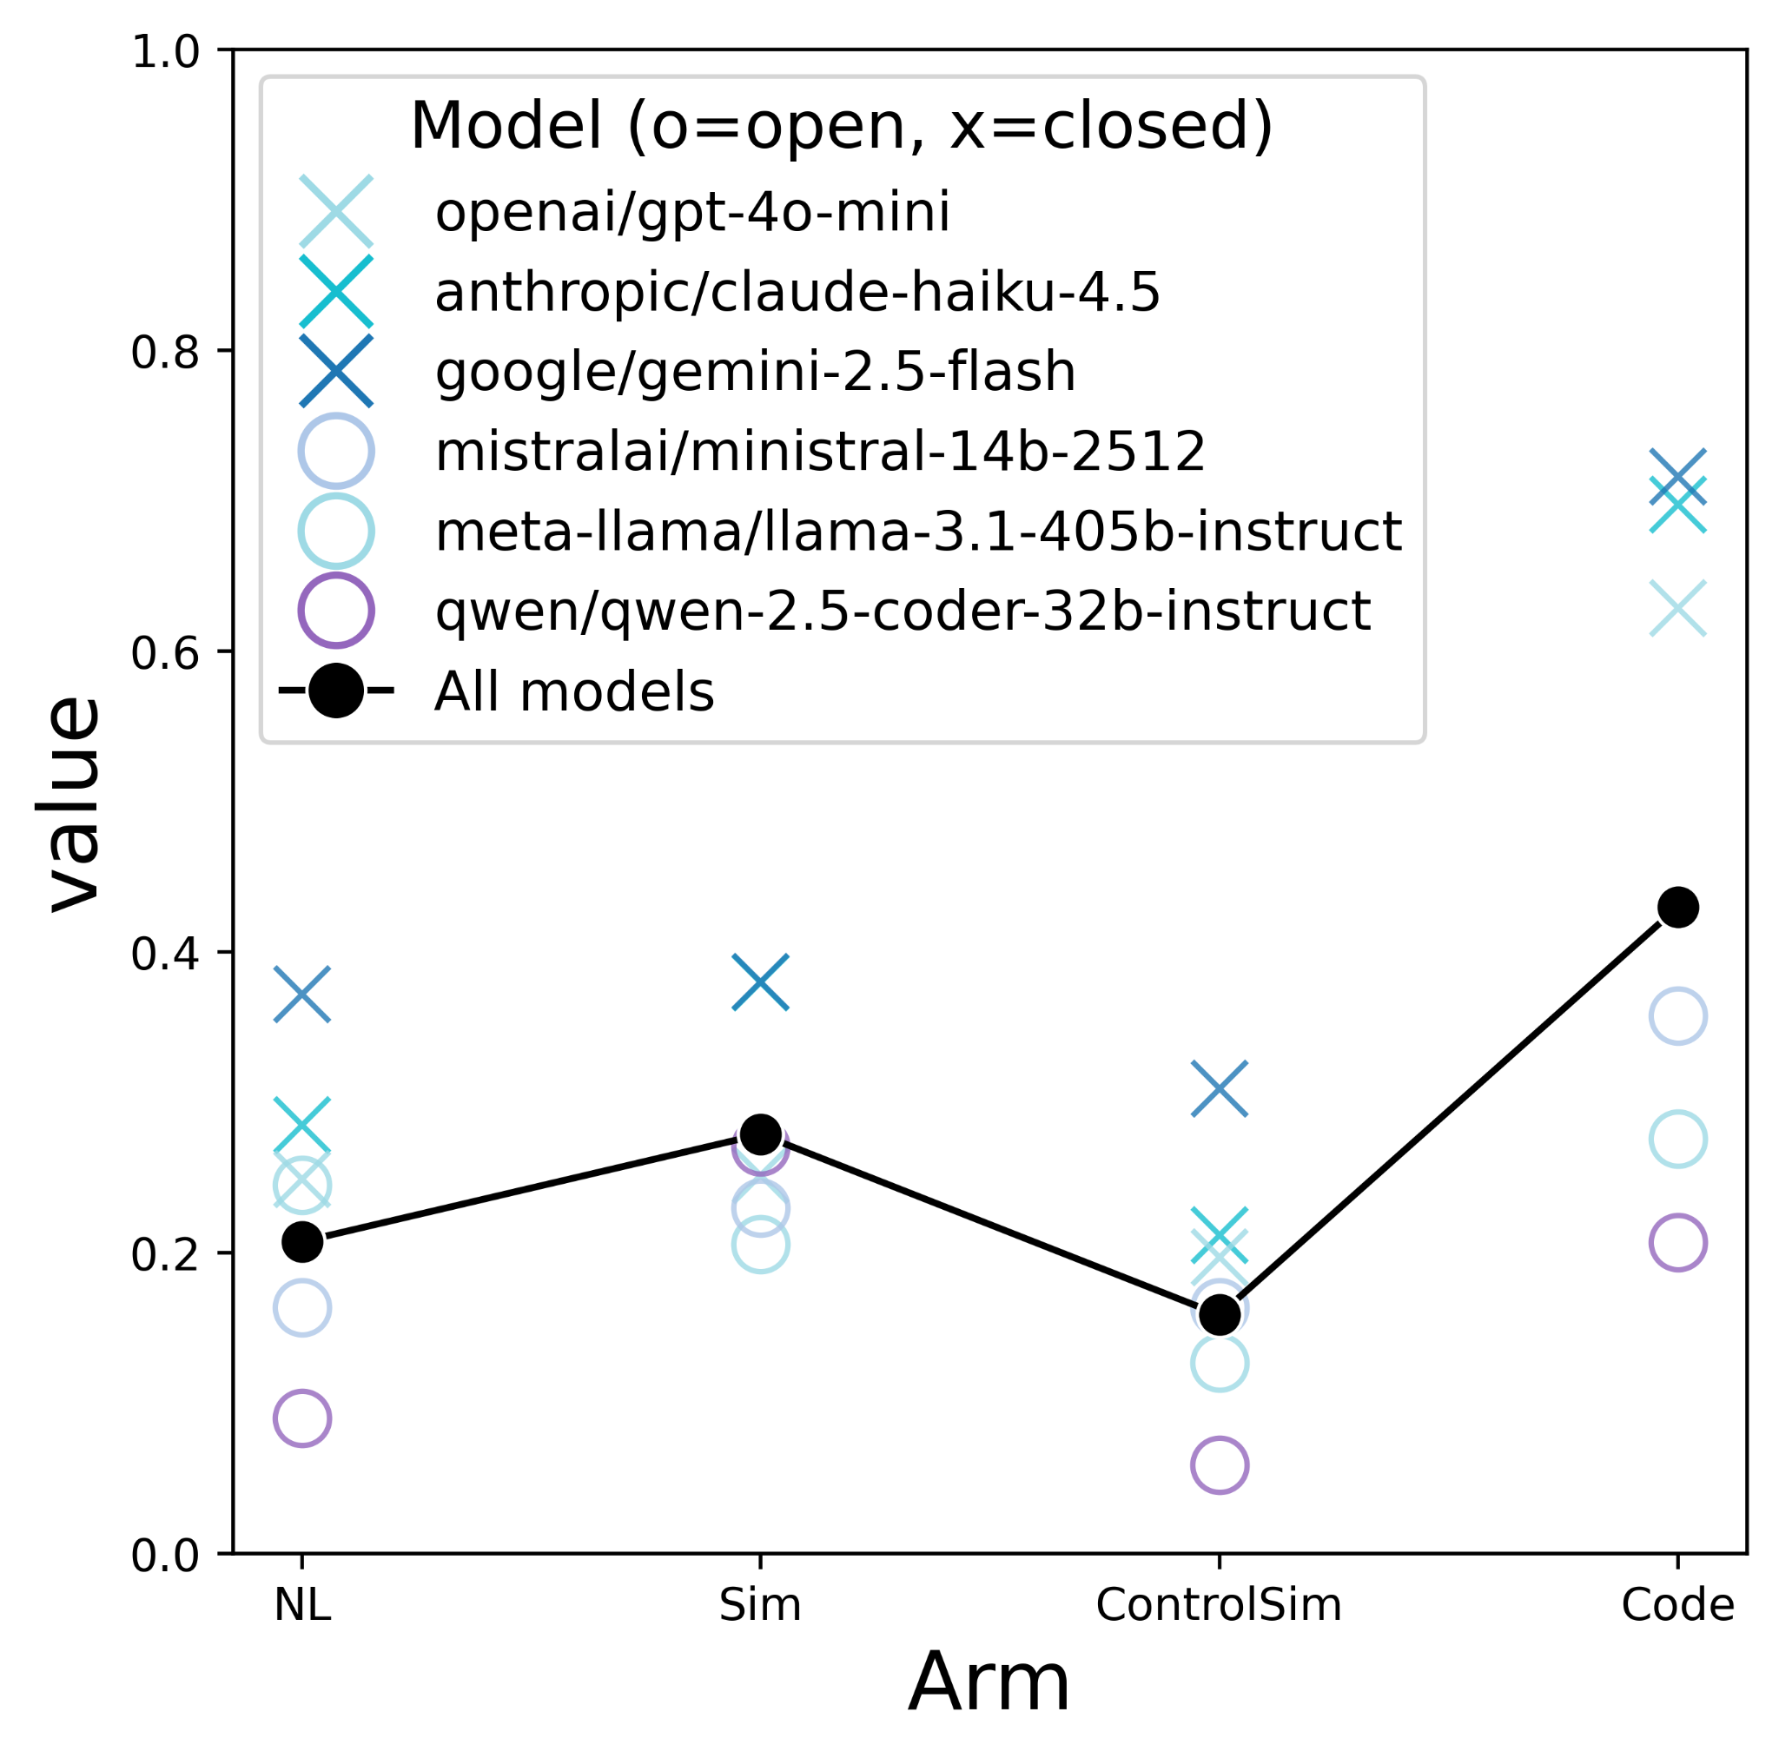
Code > NL holds when GSM8k excluded
Sampling (over 3 seeds, digits 2,4,6,...,20):
500/run GSM (1500 total)
500/run CLRS 30 (1500 total)
270 for NPHardEval (810 total)
270 for Our custom suite (810 total over 3 seeds)
Model Selection (over 10 models):
Accuracy (Higher is better)
Without prompt shortcut it does much worse

Slide 6
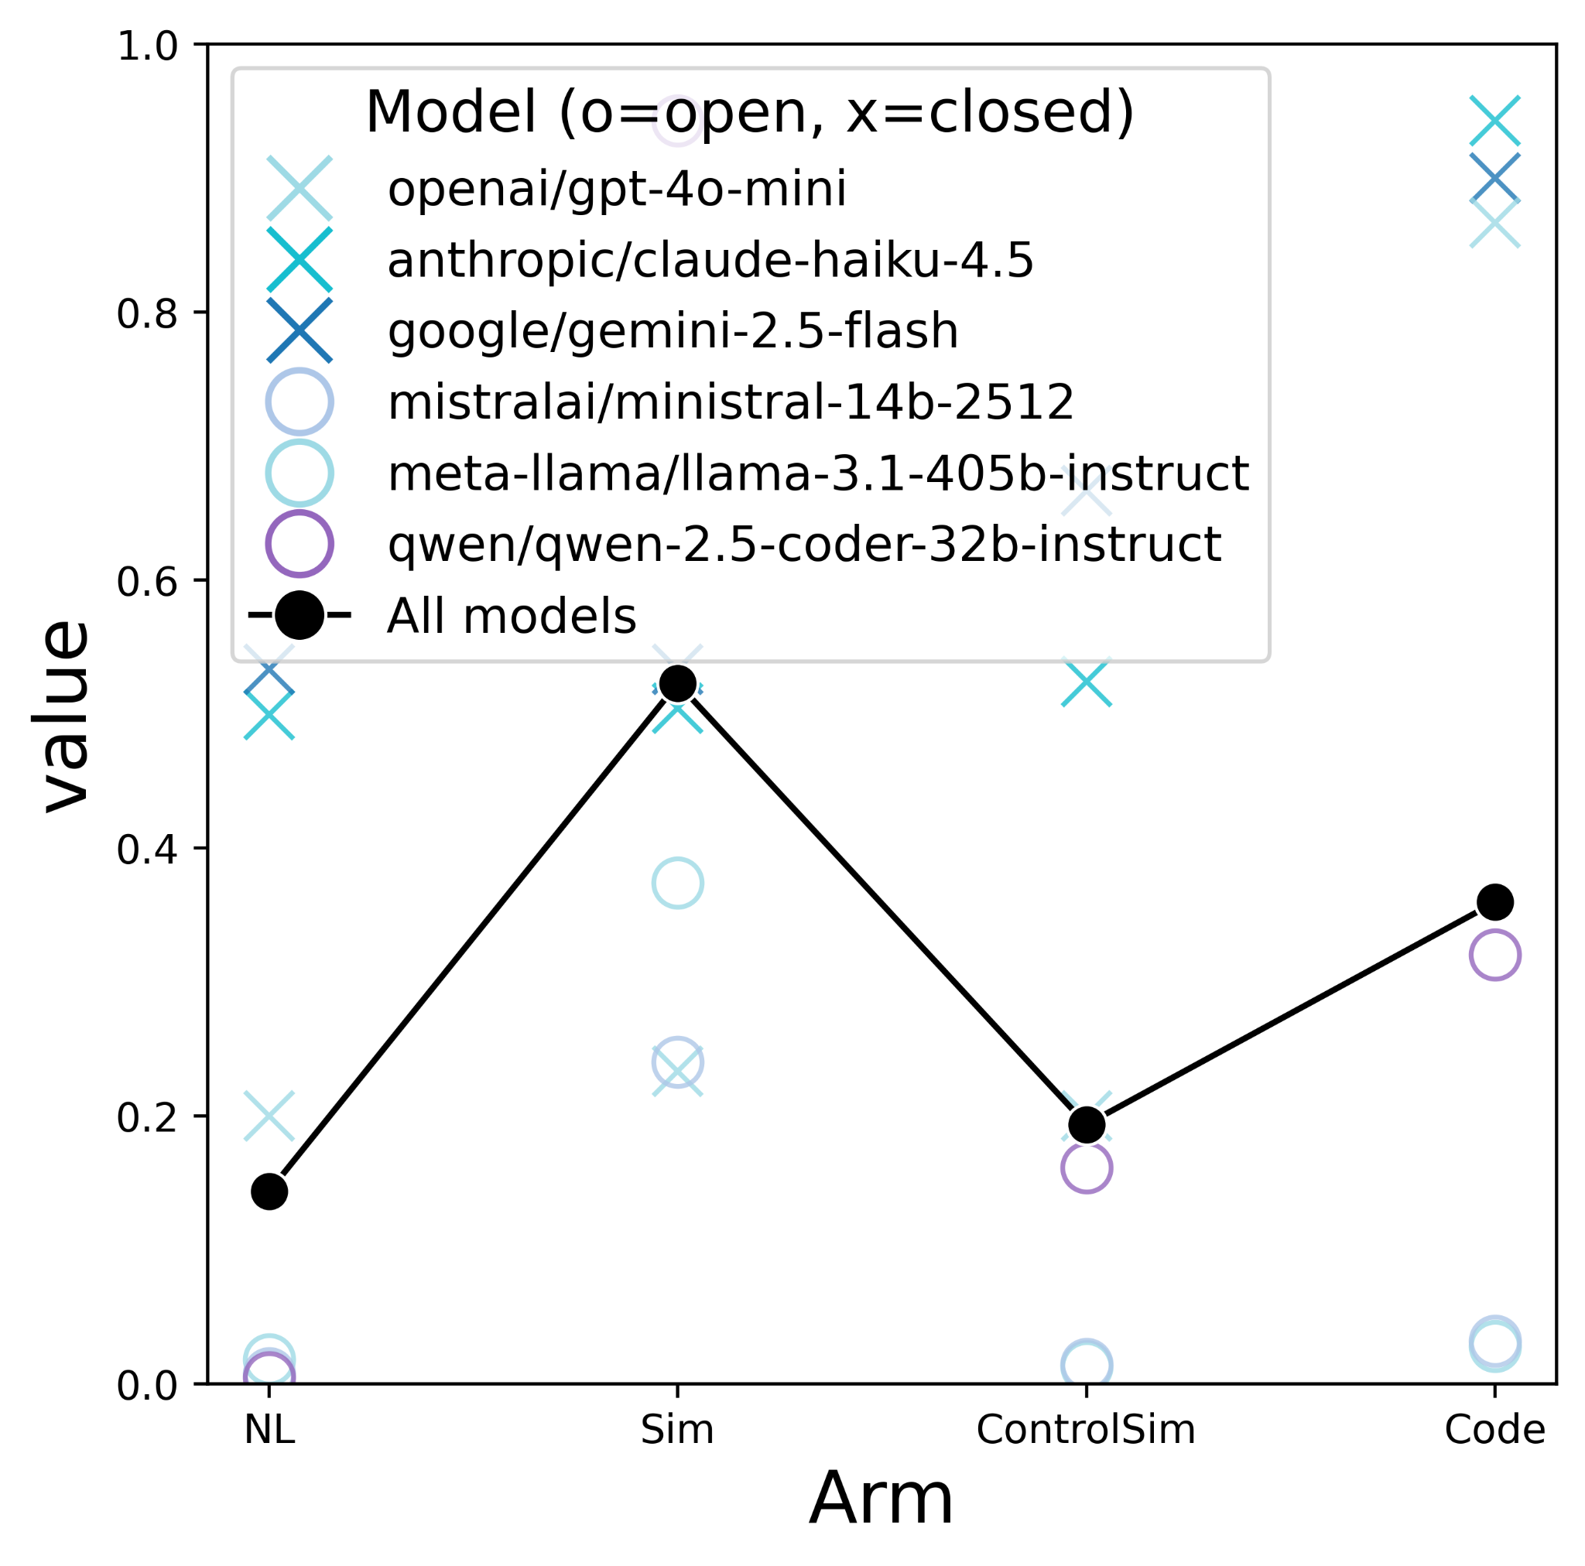
Purely GSM8K Shows that code exec is worse than simulation
Code > NL trend holds for closed models
Weaker open models break the trend. Likely due to inability to generate sound code from the NL prompt

Slide 7
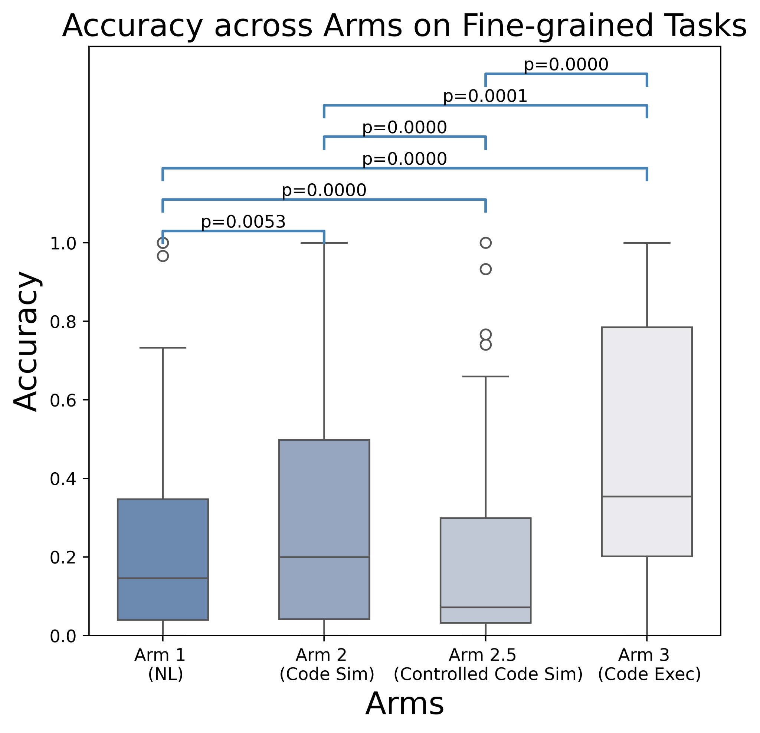
Aggregate trend is statistically significant
We see the same trend as the line plot

Slide 8
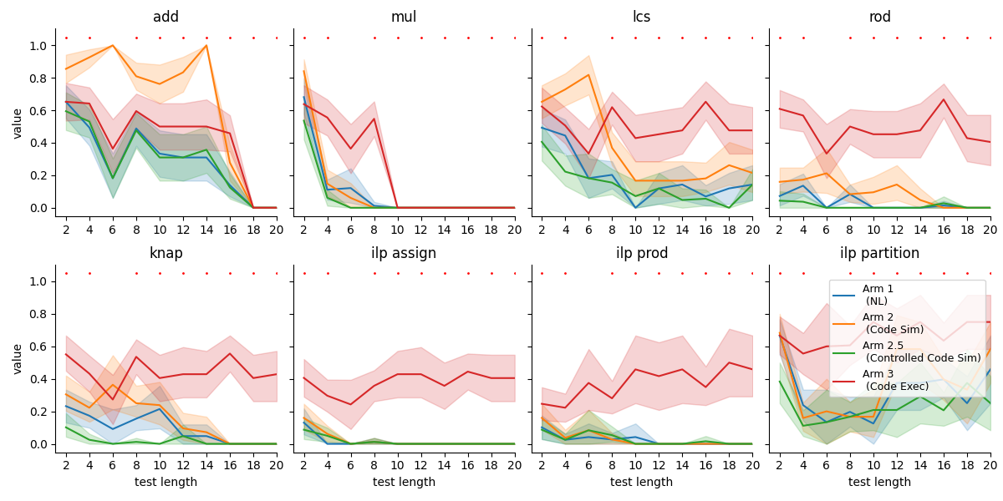
Benefits of code improves at scale
Question: Why does multiplication not generalize perfectly for code? shouldn’t it be very easy?
Rote memorization overcome be better generalization for harder difficulty

Slide 9
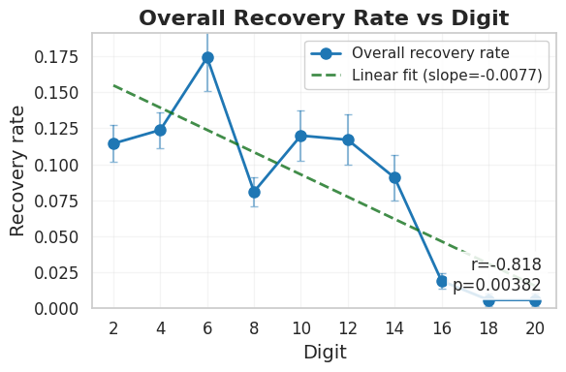
Models struggle to recover on harder tasks (can’t take shortcut)
As tasks get harder, models struggle to recover

Slide 10
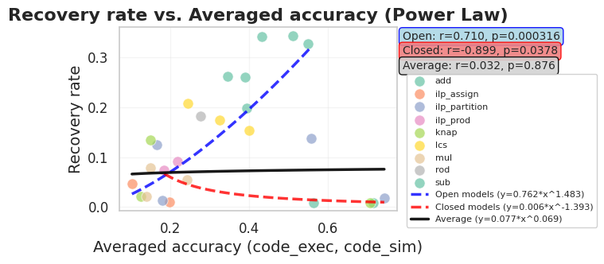
Stronger models don’t recover / take shortcut as much
Strong closed models don’t take shortcuts and have lower recovery rate as they get better (rely on actual generalization). benefits of recovery reduce as we improve our models…
Weak open models take shortcuts so as they improve in accuracy, the recovery improves

Slide 11
Logistic Setup
More structured, always starts with ```python def solution() etc…
Example NL Rationale + Label
Example 3: kind=activity_selector, digits=6
gamma (nl): activity_selector|d6|bNA
gamma (code): activity_selector|d6|bNA
nl rationale:
Using the greedy activity selector algorithm, I sorted activities by finish time. Starting with Activity 3 (finishes at 0.544), I selected it. Then Activity 1 (starts at 0.715, finishes at 0.891) was selected as it starts after Activity 3 finishes. All remaining activities overlapped with either Activity 3 or Activity 1, so no more could be selected. The maximum number of non-overlapping...
code rationale:
```python def solution() -> int: # Activity Selector Problem - Greedy Algorithm # Select maximum number of non-overlapping activities # Activities are sorted by finish time s = [0.437, 0.715, 0.602, 0.383, 0.423, 0.528] # start times f = [0.548, 0.891, 0.963, 0.544, 0.791, 0.645] # finish times # Create list of activities with indices activities = [(s[i], f[i], i) for i in range(len(s))] # Sort...

Slide 12
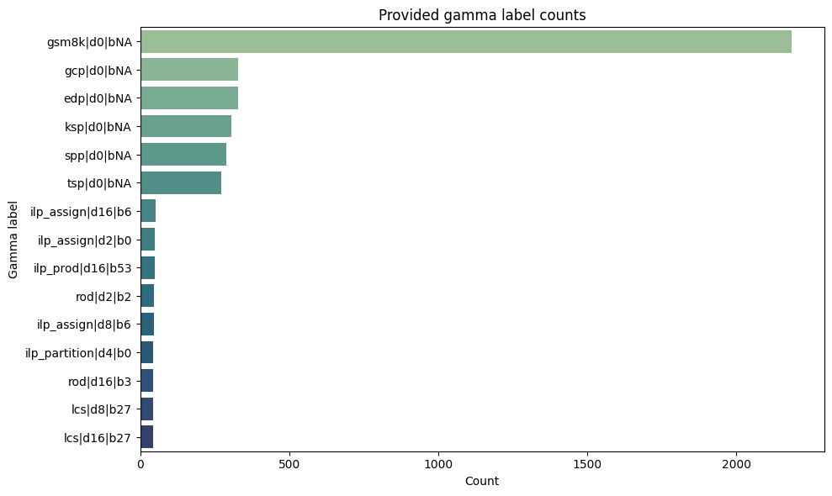
Logistic Label distribution
Should exclude NPHardEval and others, only use the base and base accuracy…
Exclude?

Slide 13
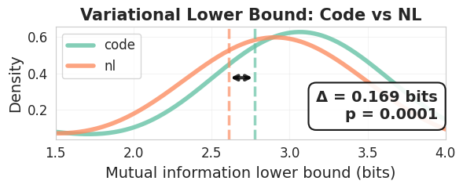
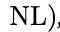
Code generally has higher variational lower bound
-

Slide 14
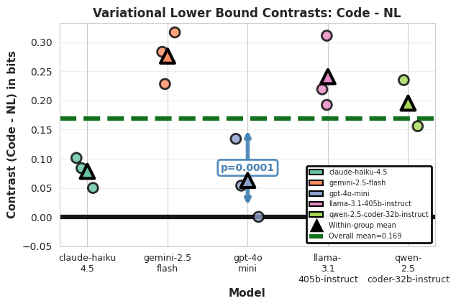
The contrasts trend for vlb holds across models
Statistically significant (wilcoxon)

Slide 15
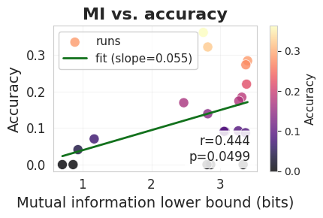
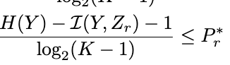
The VLB is predictive of downstream accuracy
MI variational lower bound*
Linear relationship

Slide 16
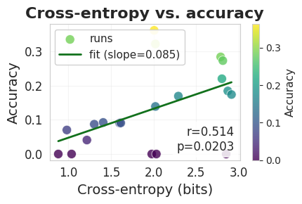
CE also predictive of downstream accuracy
Final accuracy on end task (e.g. ilp)
CE from logistic regression with nl and code that generated that final accuracy.

Slide 17
Main takeaways
Part 1:
3 arms works, but not with heavy NL / non-algorithmic tasks (e.g. gsm8k) under weak models
Models do not recover as tasks get harder
benefits of recovery reduce as we improve our models
Part 2:
MI lower bound predicts final performance
Code has higher MI than NL

Slide 18
Plans:
4 types of perturbations for noise experiments:
Numerical (perturb_numerical): Replaces a fraction of digits with random digits.
Textual (perturb_textual): Character-level noise via insertions, deletions, and swaps.
Structural (perturb_structural): Shuffles list/matrix elements (or words if no bracketed lists are found).
Irrelevant (perturb_irrelevant): Injects distractor sentences.

Slide 19
Dec 17 Agenda
Takeaway and open questions from last week (slide 3, ~ 5 mins)
Schedule and Plans ( < 10 mins)

Slide 20
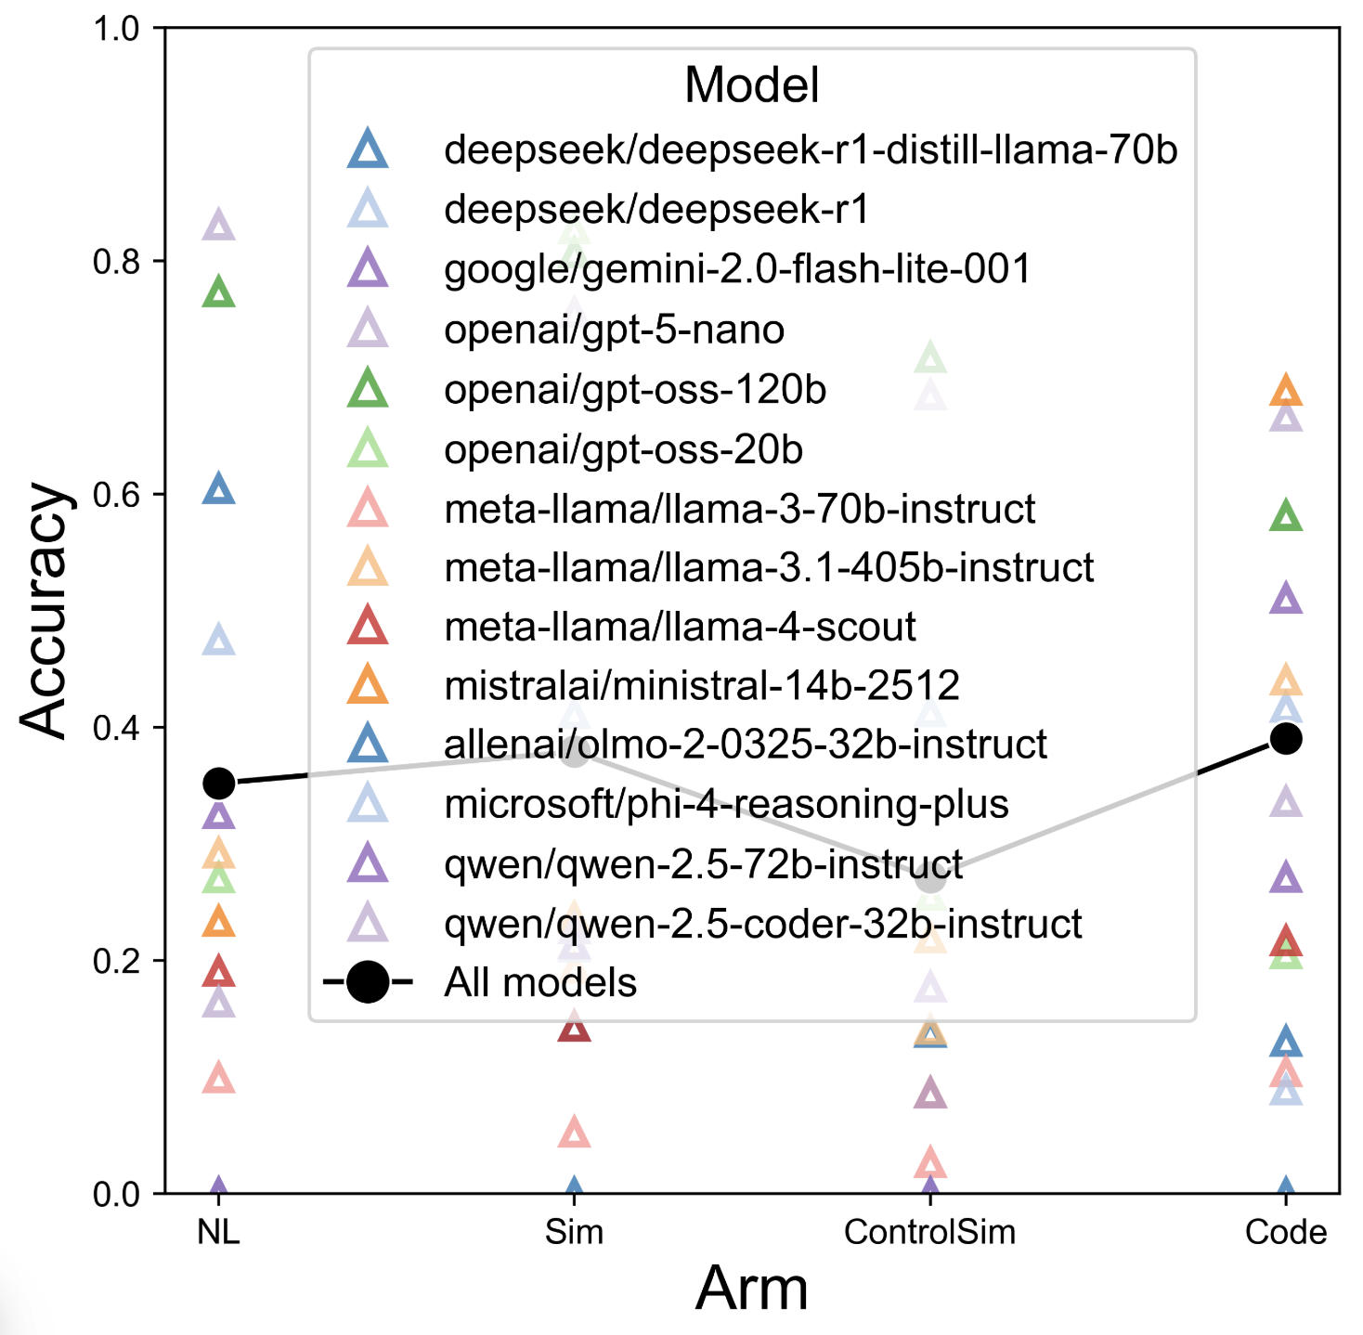
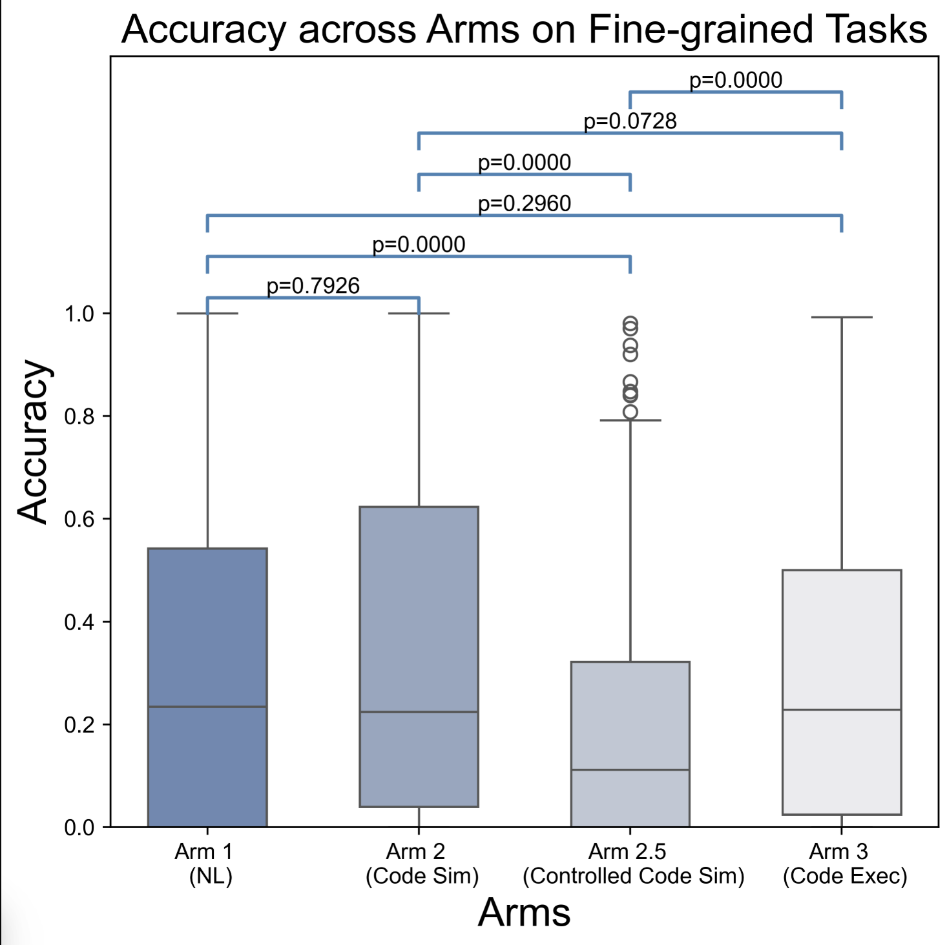
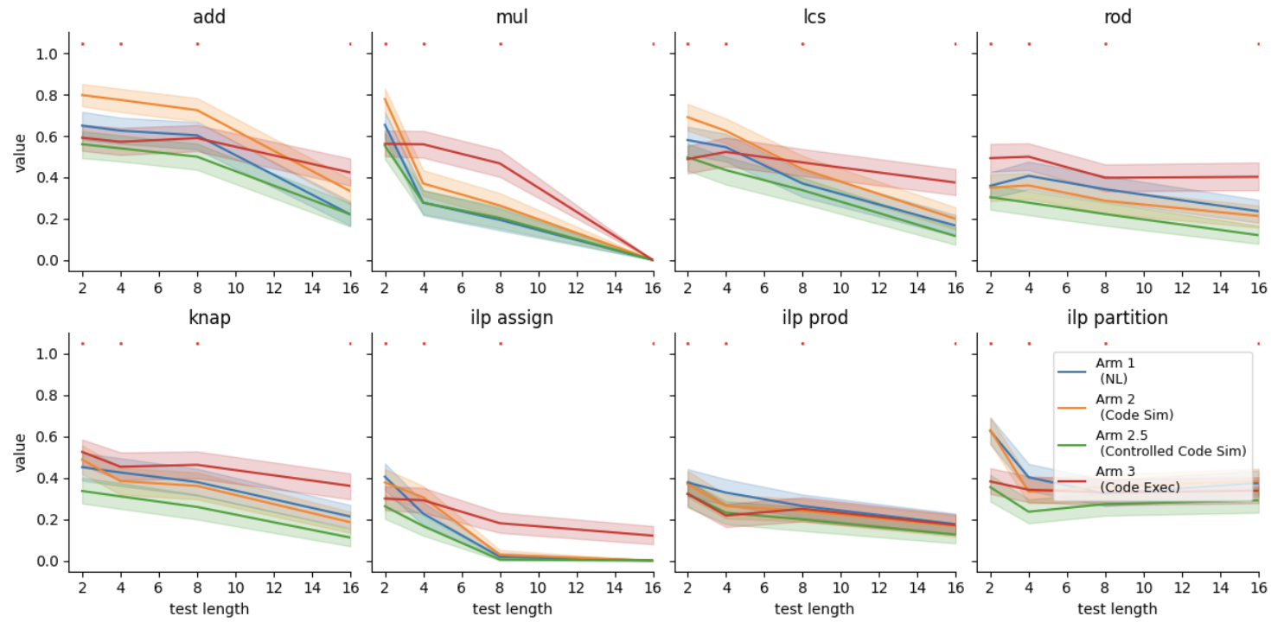
Takeaways from last week
Some models exhibit abnormal behaviour
Debug why

Slide 21
Plans (Engineering Mode)
Understand the impact of increasing samples to 500
Visualize and analyze the impact of different models
E.g. impact of model size, architecture, reasoning, code, other benchmarked abilities.
Test MI Code
Is MI Predictive of Performance
Does pre-training MI predict test time MI? How can we establish this relationship.
Noisy Exps
Look at the perturb. What is X Axis.

Slide 22
Schedule (Away until Jan 5th)
Begin working on Jan 5th
Blocked by PhD Apps, OpenRouter Costs, and Holidays

Slide 23
Dec 5 Agenda
Takeaway and open questions from last week (slide 3, ~ 5 mins)
Main Plots ( < 25 mins)
Pretraining mutual information (10 mins)
Interpreting results
how does this fit into the picture
Is MI predictive of performance? (10 mins)
What are the effects of different performances on agentic behaviour ? Does overall natural language or coding ability influence agentic behaviour?
Next steps and milestones ?
Notes:
Include prompts, hypers, error bars.

Slide 24
Summary
Last time:
Empirical Success of 3 arms experiment
Does this generalize to other models?
Are the results rigorous / robust?
Discussion:
What models would be useful signals

Slide 25
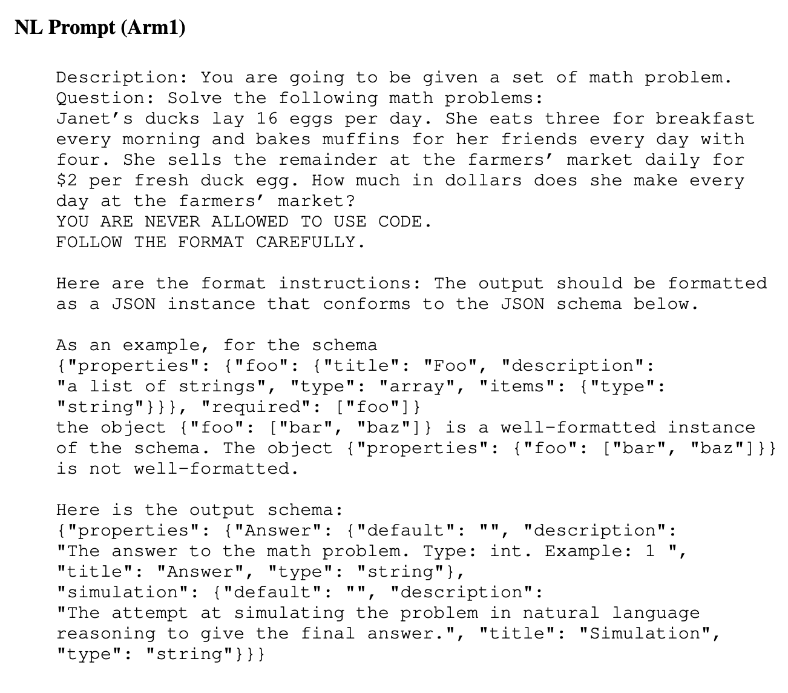
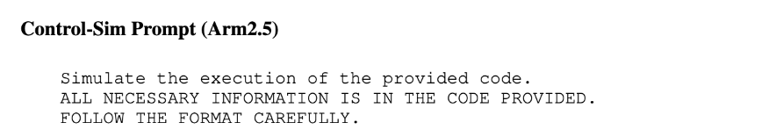
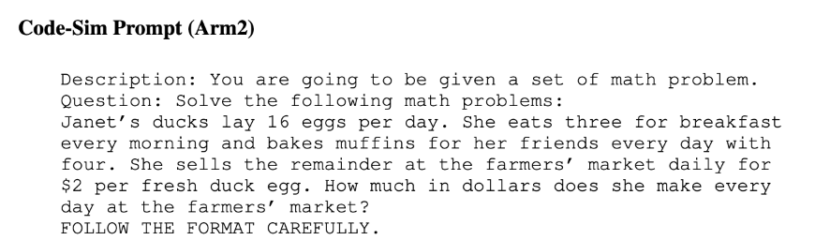
Prompts / Structured Output Schema
Example formatting:

Slide 26
Results
Results on more models, most have 2-5 seeds run.
Prompts:
Includes: NPHardEval (225), CLRS30 (25), GSM8K (25), Fine-grained (225)
Qualitative Observations: Why does open-ai models excel at NL reasoning, but not code?
Some models struggle really badly on all tasks.
How other benchmarks impact the results?
What is impact of <thinking> ?

Slide 27
Non reasoning models
Model name | Open-source/ Close-source | Note
GPT-5 Mini | Close-source | general chatbot, instruction following, or reasoning tasks
Llama 3.3 70B Instruct | Open-source
microsoft/phi-4 | Open-source

Slide 28
Model name | Open-source/ Close-source | Note
O3-mini | Close-source | Quick responses to technical questions. Optimized for STEM, excels at coding, math equations, and science questions
gemini-2.5-pro | Close-source | Complex reasoning, advanced coding, multimodal analysis State-of-the-art performance, massive context window (1 million tokens), adaptive reasoning, rich multimodal input support
claude-4-sonnet | Close-source | Everyday coding tasks, writing and document review, reading text and images. Efficient and fast, large context support, strong reasoning
DeepSeek-R1 | Open-source
Qwen/Qwen3-4B-Instruct-2507 | Open-source
Qwen/Qwen3-Coder-30B-A3B-Instruct | Open-source
Reasoning models

Slide 29
Fine-grained Results

Slide 30
Overalls

Slide 31
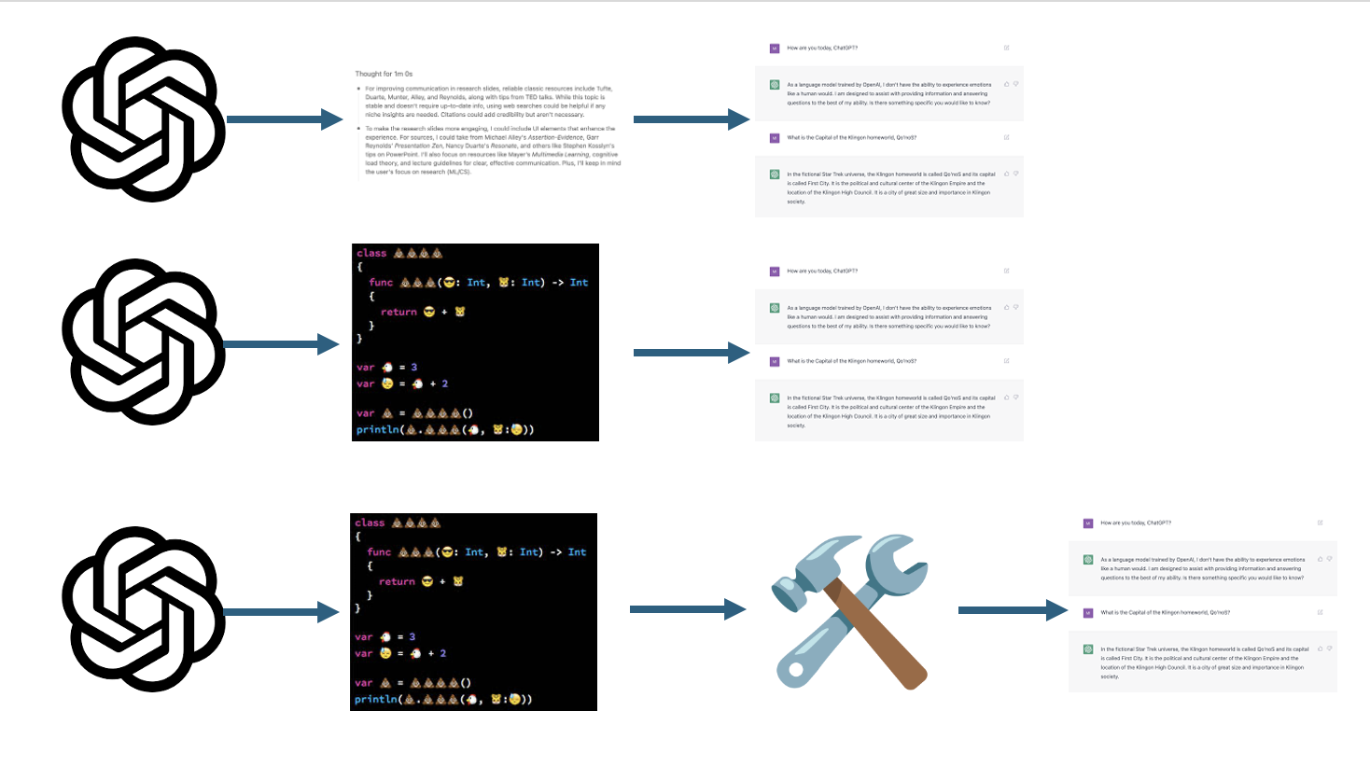




Tool Use Language Models
Research Updates
Terry Tong
Yu Feng
University of Pennsylvania,
Cognitive Computation Group
09/19/2025
Notes:
This file presents an assertion-evidence template for making effective slides for scientific presentations. Although much about the layout and typography contrasts sharply with the defaults of PowerPoint, these changes are done so to make the slides more effective at communicating technical information. The design advocated by this template arises from Chapter 4 of The Craft of Scientific Presentations, 2nd edition (Springer, 2013). The homepage for this template exists at the following website:
http://writing.engr.psu.edu/assertion_evidence.html
Rig ht now you are viewing the notes pages. To work on the slides, click on “Slide” under “View.” Tip: When creating a new presentation, save this file as the name of your presentation. Warning: You are more than welcome to use this template for your presentation slides. You may not, though, distribute this template for profit or distribute this template without giving credit to the source: http://writing.engr.psu.edu/
This slide is for the title slide of a presentation. Consider inserting an image that helps orient the audience to the title. You should not leave this slide until the audience feel comfortable with the title. Forcing yourself to spend more time with this slide is good because a common mistake in presentations is to leave the title slide too soon. Because of this mistake, many in the audience do not have the chance to comprehend the key details of the title. See pages 172-184 in The Craft of Scientific Presentations, 2nd ed. (CSP).
This template shows one layout for the slide. You might want to rearrange the placement of the body’s wording to accommodate a different sized image. On the next slide is a sample title slide. You should delete the examples after you create your own slides.

Slide 32
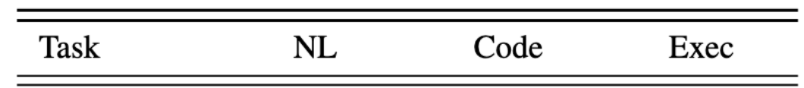
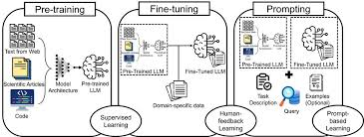
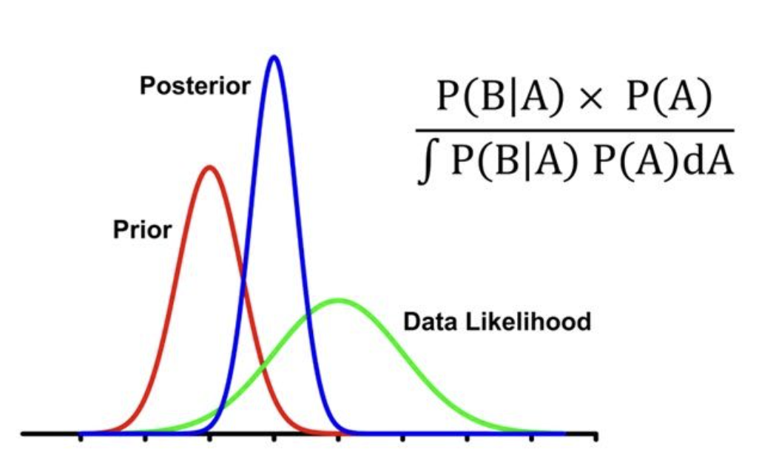
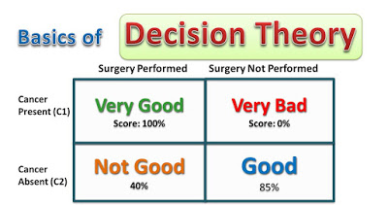
This presentation traces our research progress
What is the phenomena?
Why does it happen?
How is this useful?
Notes:
Mapping slide for the presentation (note that a background slide or a slide justifying the importance might precede this slide). A common mistake with mapping slides is to give the audience simply an unmemorable bulleted list of topics (including the names “Introduction” and “Conclusion” and “Questions”). Such a list is quickly forgotten after the slide is removed.
On a mapping slide, take the opportunity to show a key image or perhaps a representative image for each major section of the presentation. In the second case, each image would be repeated on the first visual of the corresponding section and would remind the audience that they have arrived to a major section of the presentation’s middle.
In regards to the names “Introduction” and “Conclusion,” every talk has those sections, and the names are ignored by audiences. So why state them? Also, for the divisions that you do have, find a logical and parallel grouping. Note that groups of two’s, three’s, and four’s are much easier to remember and are not so nearly intimidating as groups of five’s, six’s, and seven’s. See the discussion of mapping slides in The Craft of Scientific Presentations, 2nd ed. (pages 177-181).

Slide 33
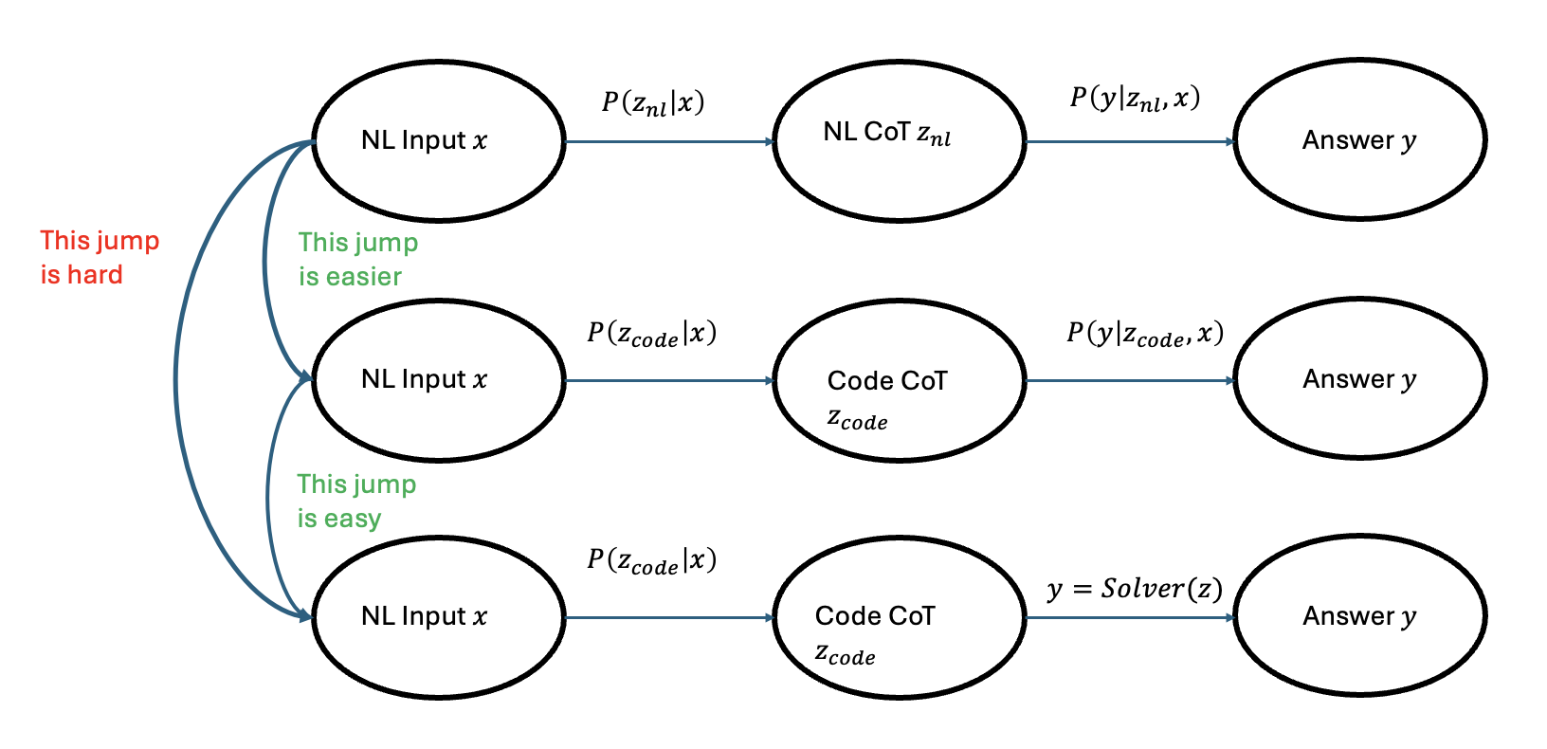
Direct Comparison is Challenging 🡪 Show a partial ordering
Notes:
Blank slide for drafting mapping slide
Use the tasks for applications.

Slide 34
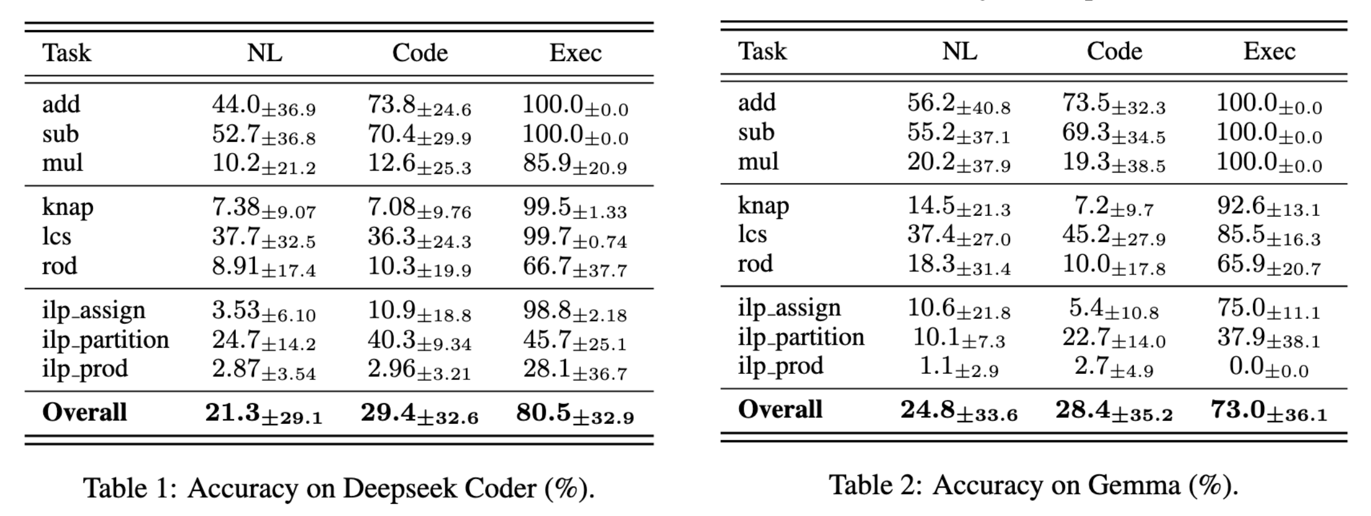
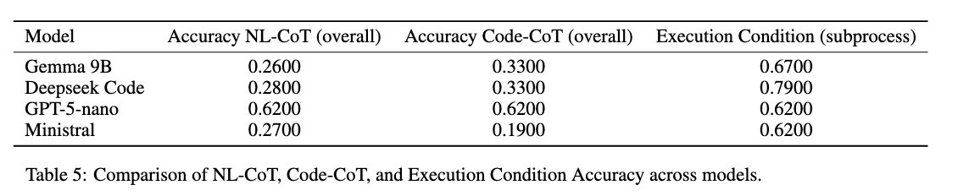
Execution is better than Code, which is better than Natural Language at solving Arithmetic, Dynamic Programming, ILP
Notes:
Body slide from the first section of the presentation’s middle. Consider having the first-topic image from the mapping slide repeated here. Use the headline (no more than two lines) to make an assertion about this topic. In the body of the slide, support that headline with images and with words, if necessary. See Chapter 4 of The Craft of Scientific Presentations, 2nd ed.
This slide shows one orientation for the image and text in the body of the slide. Other orientations appear in this template. Choose the one that best supports your headline assertion.
Some institutions will insist that you place an institutional logo on each slide. Other institutions recommend a logo on the first slide and the last. If you do place a logo on each slide, make sure that logo is at the bottom of the slide rather than the top. Placing the logo at the top (the place on a slide that receives the most emphasis) shifts the emphasis away from the work.

Slide 35
This presentation traces our research progress
What is the phenomena?
Why does it happen?
How is this useful?
Notes:
Mapping slide for the presentation (note that a background slide or a slide justifying the importance might precede this slide). A common mistake with mapping slides is to give the audience simply an unmemorable bulleted list of topics (including the names “Introduction” and “Conclusion” and “Questions”). Such a list is quickly forgotten after the slide is removed.
On a mapping slide, take the opportunity to show a key image or perhaps a representative image for each major section of the presentation. In the second case, each image would be repeated on the first visual of the corresponding section and would remind the audience that they have arrived to a major section of the presentation’s middle.
In regards to the names “Introduction” and “Conclusion,” every talk has those sections, and the names are ignored by audiences. So why state them? Also, for the divisions that you do have, find a logical and parallel grouping. Note that groups of two’s, three’s, and four’s are much easier to remember and are not so nearly intimidating as groups of five’s, six’s, and seven’s. See the discussion of mapping slides in The Craft of Scientific Presentations, 2nd ed. (pages 177-181).

Slide 36
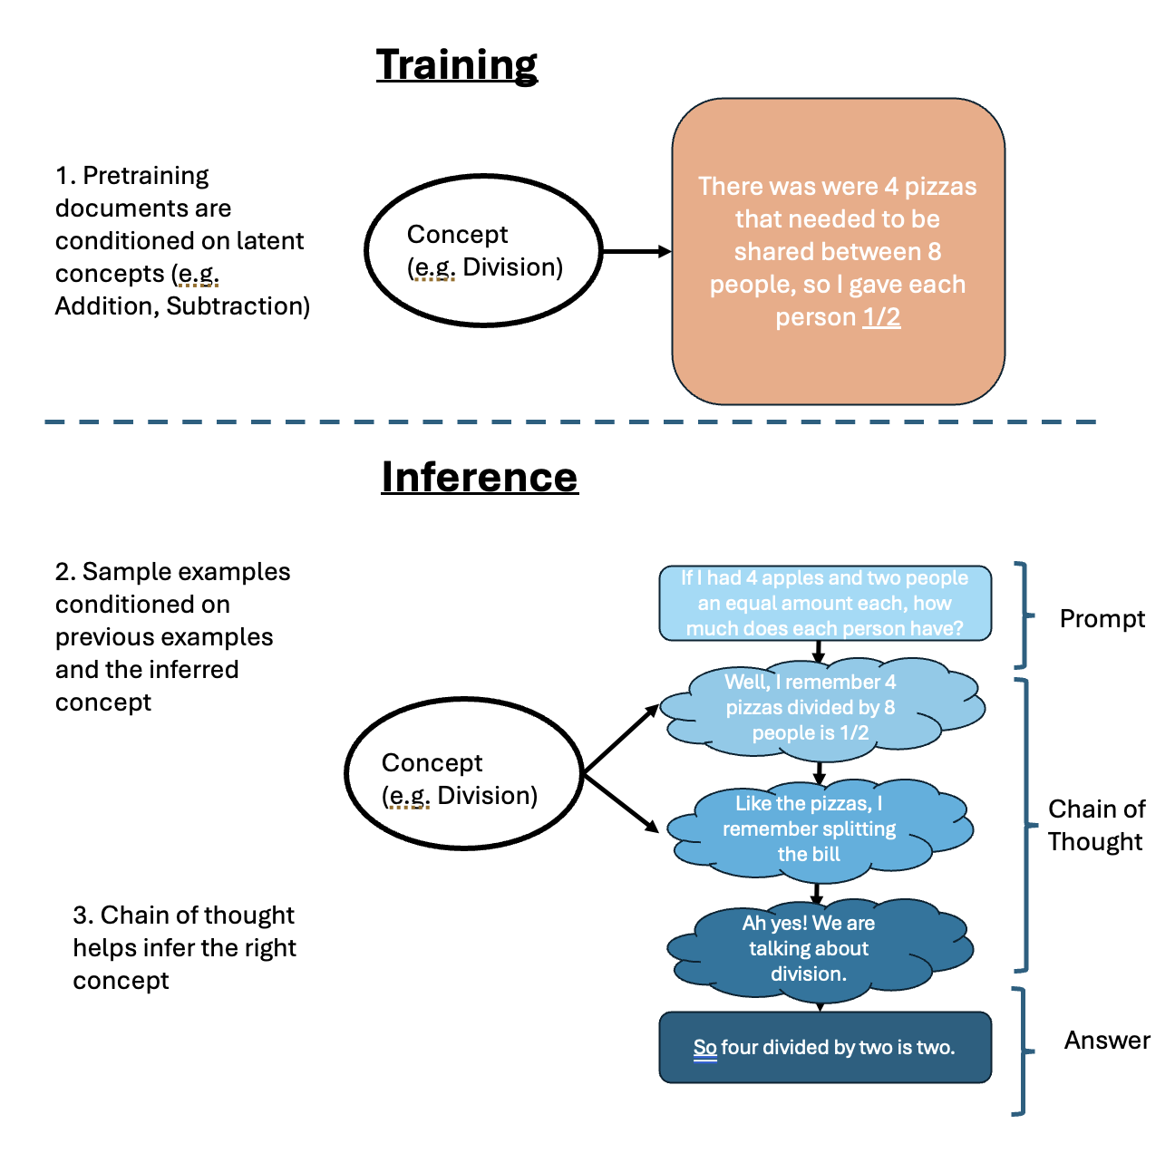
Better Code Pretraining 🡪 Higher MI 🡪 Better Tool Use
Notes:
Body slide from the first section of the presentation’s middle. Consider having the first-topic image from the mapping slide repeated here. Use the headline (no more than two lines) to make an assertion about this topic. In the body of the slide, support that headline with images and with words, if necessary. See Chapter 4 of The Craft of Scientific Presentations, 2nd ed.
This slide shows one orientation for the image and text in the body of the slide. Other orientations appear in this template. Choose the one that best supports your headline assertion.
Some institutions will insist that you place an institutional logo on each slide. Other institutions recommend a logo on the first slide and the last. If you do place a logo on each slide, make sure that logo is at the bottom of the slide rather than the top. Placing the logo at the top (the place on a slide that receives the most emphasis) shifts the emphasis away from the work.

Slide 37
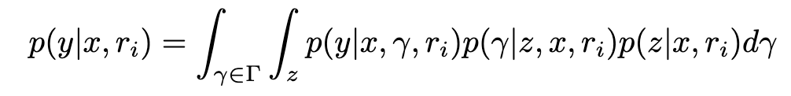
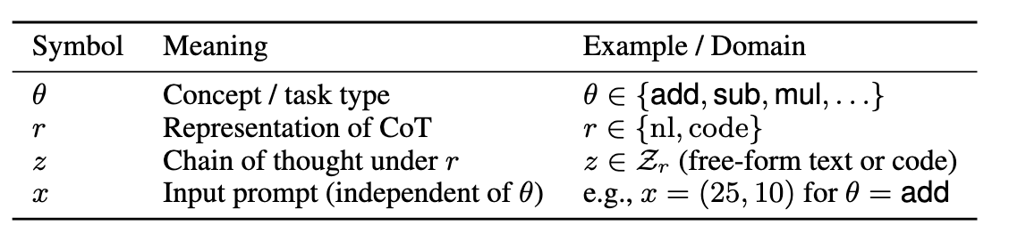
Problem solving is marginalizing in Bayesian inference, and using concept (e.g. LDA)
Concept helps infer answer
CoT is generated by input prompt x
CoT helps infer concept
Notes:
Body slide from the second section of the presentation’s middle. For the first body slide of this second section, consider repeating the corresponding image (or equation) from the mapping slide. Use the headline to make an assertion about this topic. In the body of the slide, support that headline assertion with images and needed callouts. See Chapter 4 of The Craft of Scientific Presentations, 2nd ed.
This slide shows one orientation for the image and text in the body of the slide. Other orientations appear in this template. Choose the orientation that best supports your headline assertion.

Slide 38
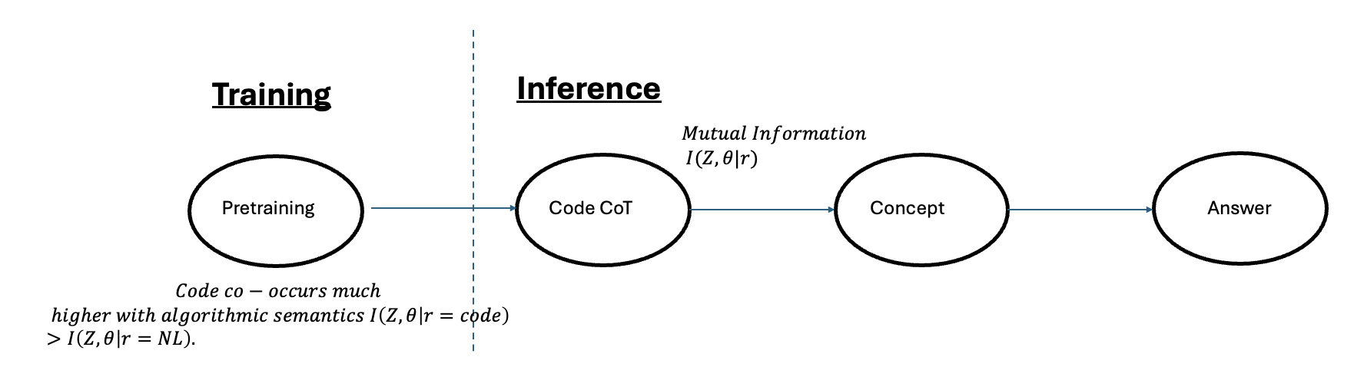
This pipeline helps explain why code > NL for problem solving
P(Y| . ) unreliable

Slide 39
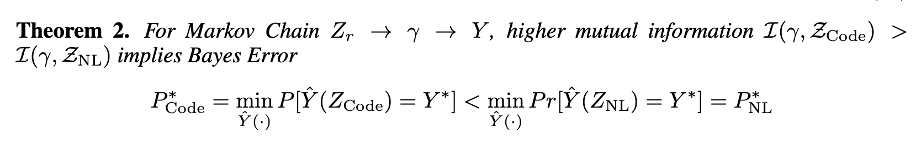

Higher MI 🡪 Lower Final Error Rate

Slide 40
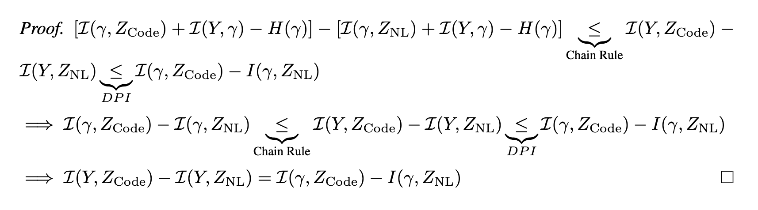

Slide 41
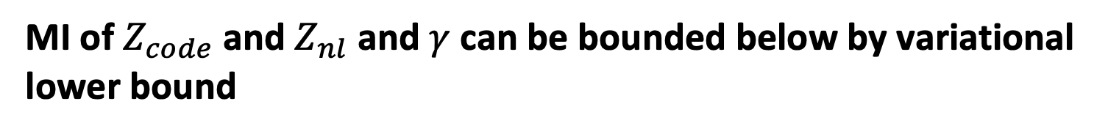
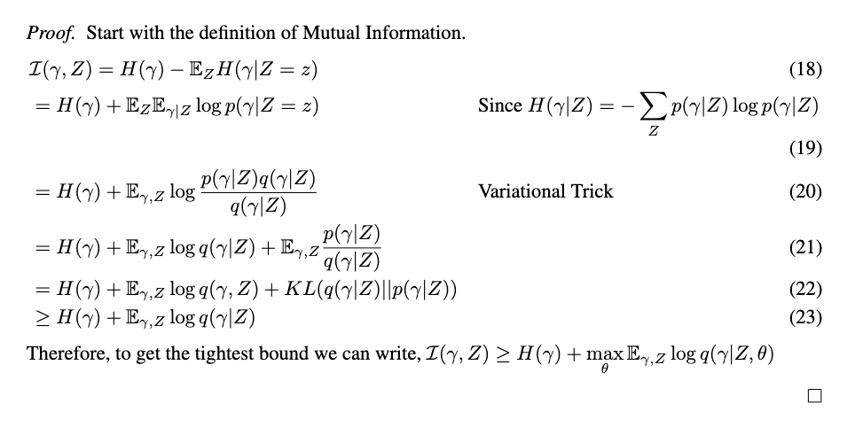
Estimate via Logistic Regression

Slide 42
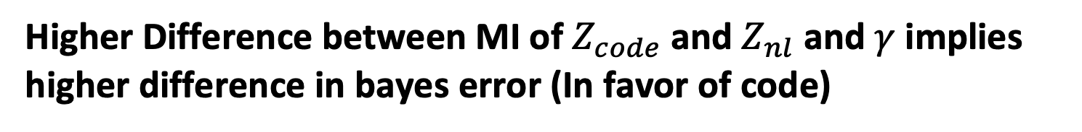
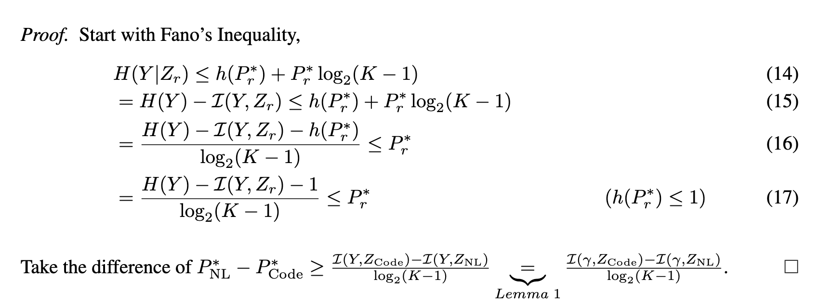

Slide 43
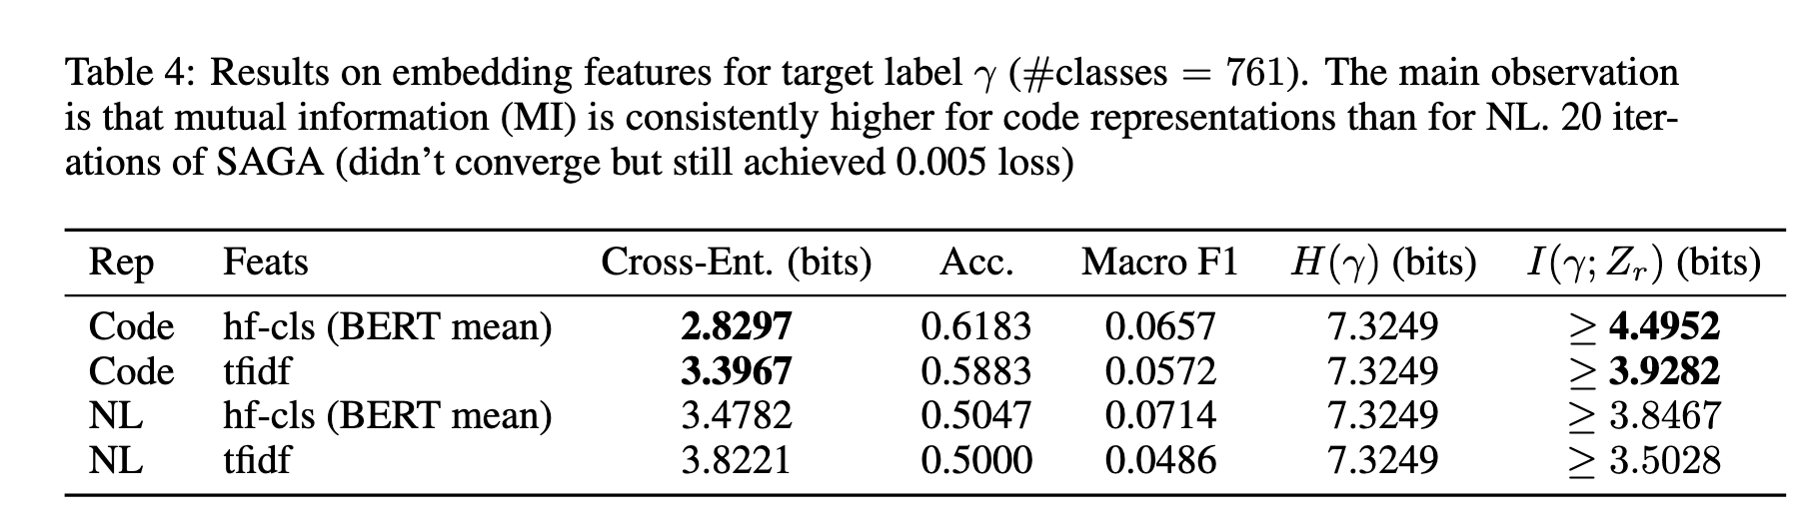
NL has higher Cross-Entropy than Code at predicting the class
Gamma is (Concept, Digit, Instance). Instances Discretized. Drop samples < 1. (only 70/9601 datapoints dropped)
Another Observation: Better Discrimination
Higher lower bound, this is what we want

Slide 44
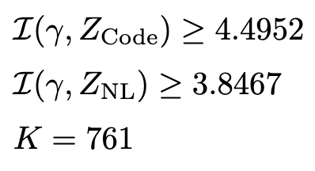
Code is theoretically at least 6% better than NL at predicting Y.
Empirical Cross Entropies via Lemma 2
Notes:
Approximating w/ Logistic Regression Model 🡪 how good is this approximation?

Slide 45
This presentation traces our research progress
What is the phenomena?
Why does it happen?
How is this useful?
Notes:
Mapping slide for the presentation (note that a background slide or a slide justifying the importance might precede this slide). A common mistake with mapping slides is to give the audience simply an unmemorable bulleted list of topics (including the names “Introduction” and “Conclusion” and “Questions”). Such a list is quickly forgotten after the slide is removed.
On a mapping slide, take the opportunity to show a key image or perhaps a representative image for each major section of the presentation. In the second case, each image would be repeated on the first visual of the corresponding section and would remind the audience that they have arrived to a major section of the presentation’s middle.
In regards to the names “Introduction” and “Conclusion,” every talk has those sections, and the names are ignored by audiences. So why state them? Also, for the divisions that you do have, find a logical and parallel grouping. Note that groups of two’s, three’s, and four’s are much easier to remember and are not so nearly intimidating as groups of five’s, six’s, and seven’s. See the discussion of mapping slides in The Craft of Scientific Presentations, 2nd ed. (pages 177-181).

Slide 46
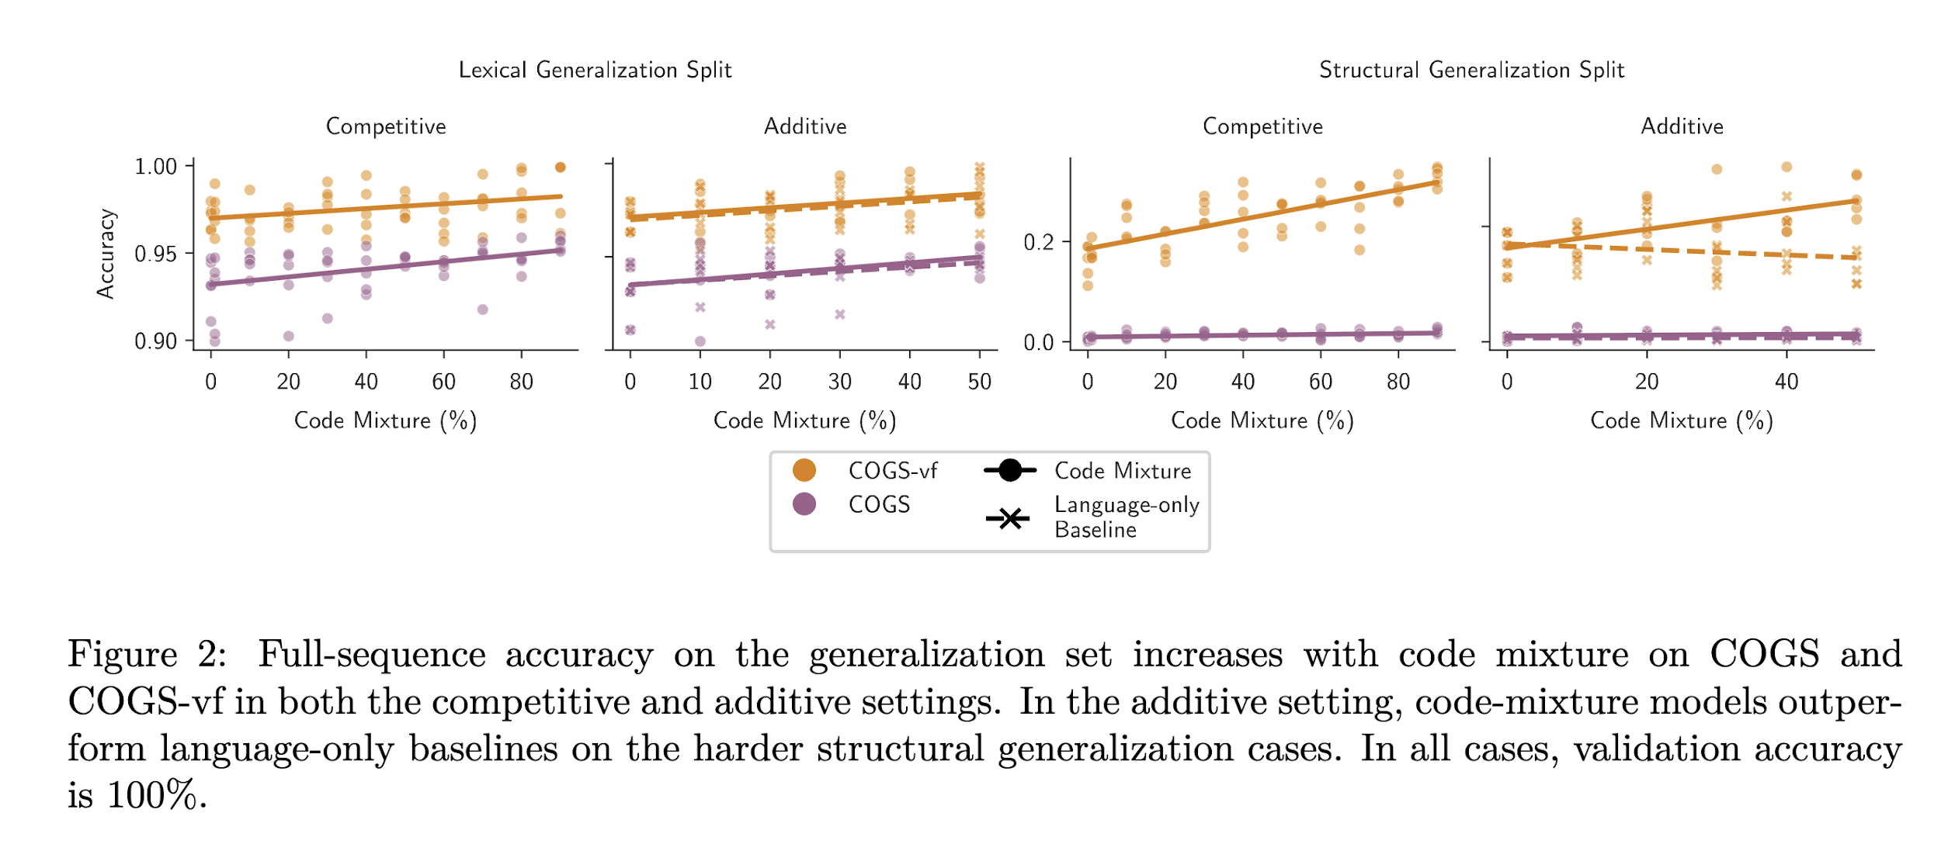
Hyp0: Pretraining Code Provides a much better signal over NL at discriminating between concepts.
How Does Code Pretraining Affect Language Model Task Performance? TMLR 24’
Notes:
For tool-use, it seems that structural outputs are more important than lexical stuff.
Algorithmic Concepts, so code should be better. Find the MI.
COGS is semantic parsing benchmark.
Within Coding itself, we should find that more structured examples, i.e. algorithmic, lead to the best output. We can run a statistical test on this.

Slide 47
Evaluation of Hyp0: 80% Success Rate, 3 Day Execution
Tasks
Find open-source models (e.g. Marin-8B-Instruct) (30 min)
Subsample their datasets, split into code v.s. general, i.e. DCLM Baseline https://huggingface.co/datasets/mlfoundations/dclm-baseline-1.0 v StarCoder https://huggingface.co/datasets/bigcode/starcoderdata (6 hours) (Here rn).
Embed using sentence-transformers mini-LM
Do Retrieval Using queries of algorithms (6 hours) (weak supervision)
Train Logistic Reg Model (2 hours)
Notes:
2,308.5 tokens total, wanna subsample just like 1%, i.e. a billion tokens? IF you care about tools, replay code data. https://github.com/marin-community/marin/issues/702

Slide 48
Story / Quick Abstract
Why is the problem interesting?
People instinctively call tools to solve algorithmic problems, but why is it better? 🡪 Data? Algorithm? Model? Task Distribution?
What is the insight / challenge?
How can we grapple with two drastically different settings with different i/o? 🡪 Mathematical Linguistics / Statistical Learning Theory won’t work too well.
Sol: 3 arms, Lets try pairwise, rather than mutual, comparison for tractability
How?
How is this useful?
For practitioners, understanding for what types of (algorithmic) problems benefits more / less from tools informs the data / learning algorithm they choose.
Notes:
Need to call tools essential. Formal way to justify why tools in certain settings is advantageous. Solver. Shortcoming, coming up w/ theoretical result.

Slide 49
What we already have
3 arms experiment + explanation
Showing 1st arm < 2nd arm (3 arms)
Showing 2nd arm < 3rd arm (Statistical Analysis) 🡪 This week
Follow-up Questions we (pre-emptively) answered:
Why is 1st arm < 2nd arm? Mutual Info + Pretraining
Why is 2nd arm < 3rd arm? Solver is deterministic 🡪 1 Mutual Info
Challenges solved on the way?
How can we begin to reason about capturing NL vs Structured Language and compare them? 🡪 Information

Slide 50
What we need
When are tools good / bad for algorithms?
Now that we know MI is higher, does this arise from pretraining?
Scale up experiments to bigger / more diverse models?

Slide 51
Further Notes
LoR’s email received
Oumi
Next ideas

Slide 52
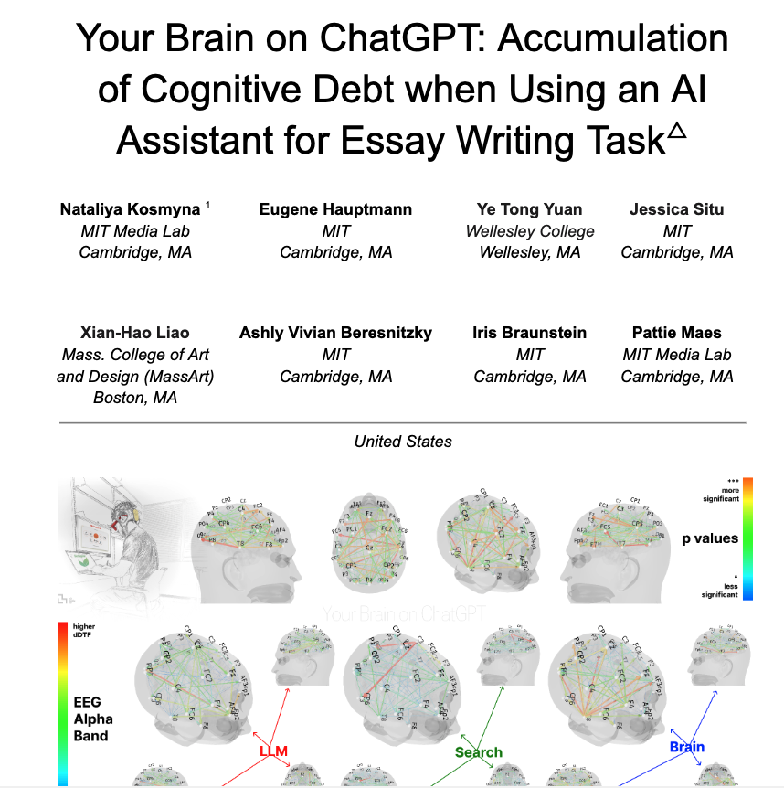
LLM Brain on ChatGPT
Agents continually learn w/ Tools
Individual performance Degradation?

Slide 53
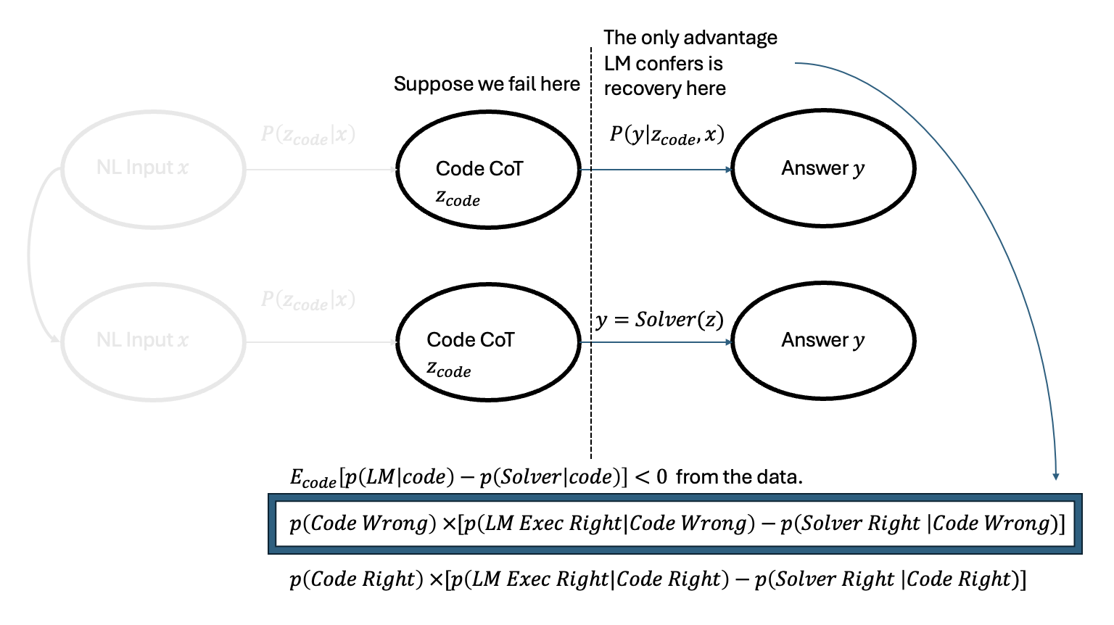
Hyp1: LM’s rarely (<0.05) overcome failed CoT
Notes:
Partial Correlations

Slide 54
Prior experiment has 90% Success Rate and will take 2 days to execute
Tasks:
Let X = initial code generation
Compute P(X = fail), and thus P(X = succeed) = 1- P(X=fail)
LM Quantities:
Compute P(LM Succeeds | X = Fail), P(LM Succeeds | X = succeed).
Compute P(LM Fail | X = Fail), P(LM Fail | X = succeed).
Solver Quantities
Compute P(Solver succeeds | X = Fail), P(Solver succeeds | X = succeed)
Compute P(Solver succeeds | X = Fail), P(Solver succeeds | X = succeed)

Slide 55
Overall Means Meet our Expectation
OLMO
Overall Code Exec Correct
Mean 0.103300
std 0.304366
Name: correct_code_exec
Overall Code Sim:
mean 0.028600
std 0.166688
Name: correct_code_sim,
Overall Exeuctable Code:
mean 0.309600
std 0.462352
Name: executable_code
Overall NL:
mean 0.03030
std 0.17142
Name: correct_nl
GEMMA
Overall Code Exec Correct mean:
mean 0.72950
std 0.44424
Name: correct_code_exec,
Overall Code Sim:
mean 0.283300
std 0.450623
Name: correct_code_sim
Overall Exeuctable Code:
mean 0.798700
std 0.400992
Name: executable_code
Overall NL:
mean 0.247900
std 0.431815
Name: correct_nl
DEEPSEEK
Overall Code Exec Correct
mean 0.804600
std 0.396528
Name: correct_code_exec
Overall Code Sim:
mean 0.293800
std 0.455524
Name: correct_code_sim
Overall Exeuctable Code:
mean 0.851600
std 0.355514
Name: executable_code
Overall NL:
mean 0.213000
std 0.409448
Name: correct_nl
Notes:
Add another metric for ratios / reductions
Emphasize on why these tasks are the ones that are important, or if we need more?
Add Marin and Qwen 32B.

Slide 56
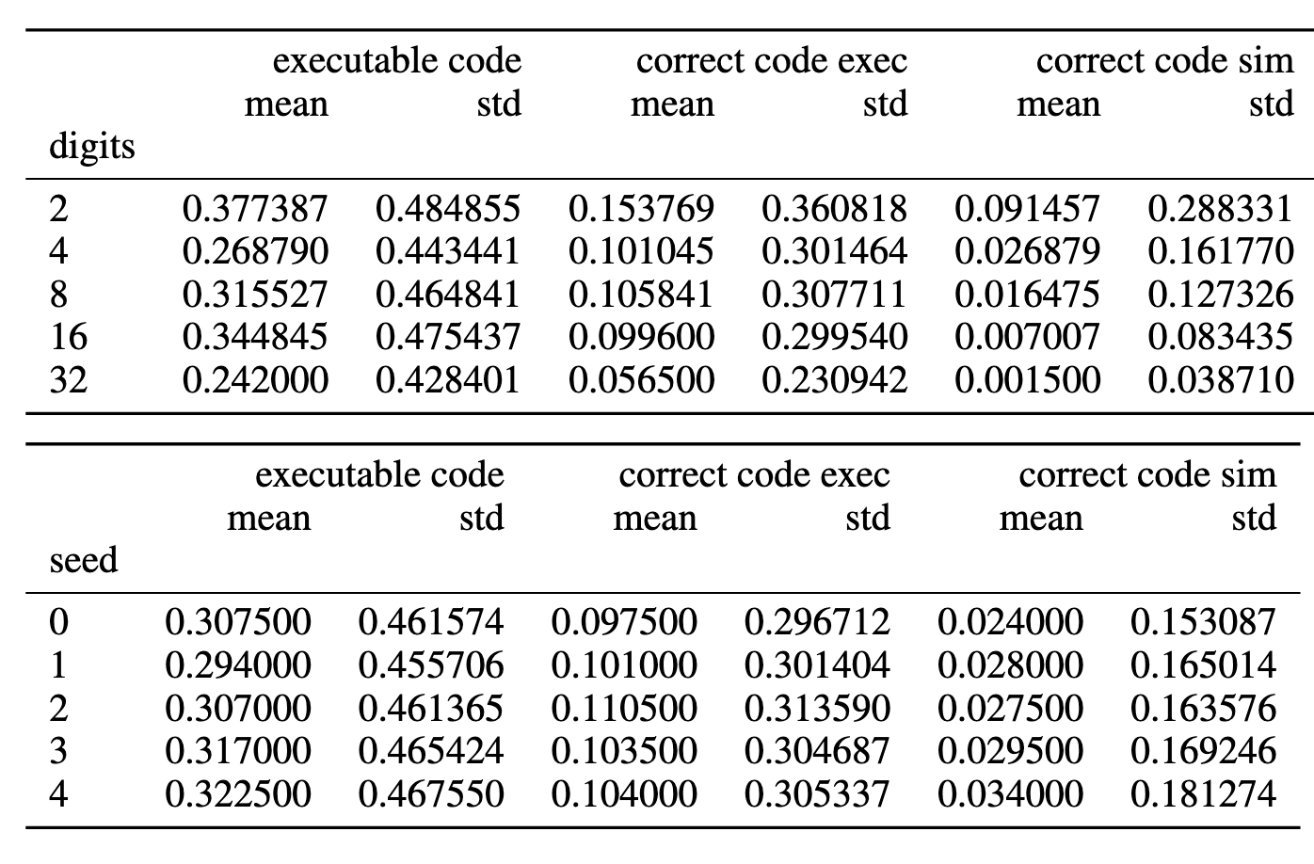
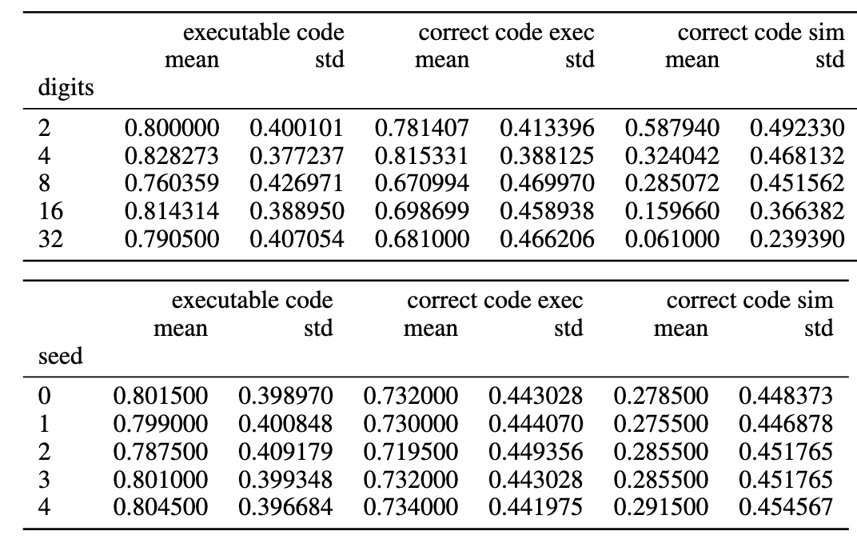
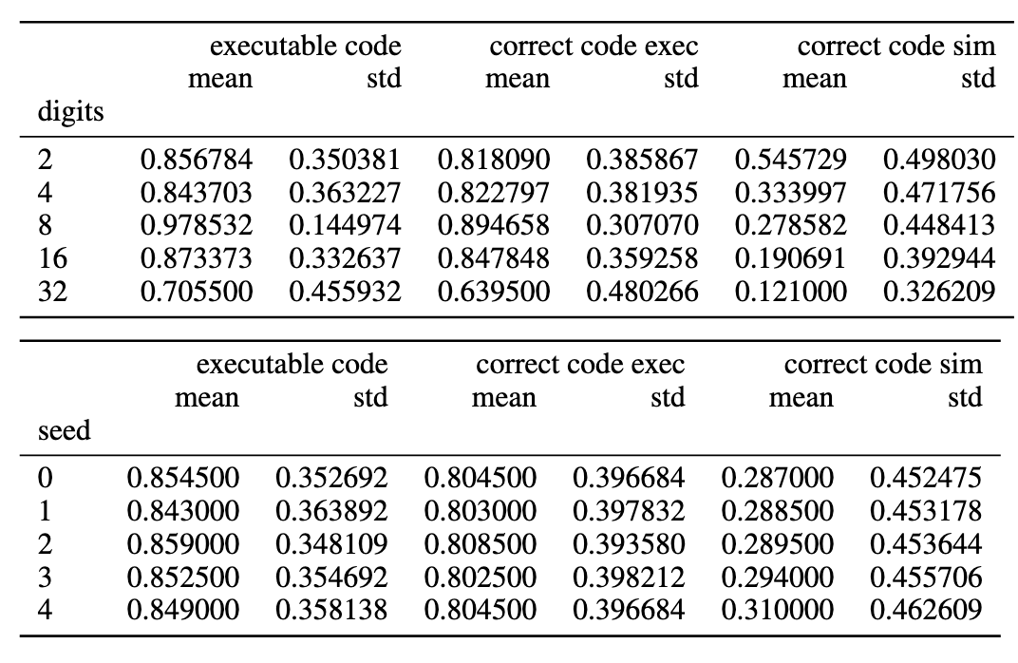
Fine grained Accuracy Results
OLMO
GEMMA
DEEPSEEK

Slide 57
Likelihood Ratio of Contingency Tables show correlation between each of the code categories
OLMO
We are 1.8959316700382107 more likely to observe executable_code with correct_code_sim than with not executable_code. We have p-value, 1.1806017078591974e-07
We are 6914.0397479398935 more likely to observe executable_code with correct_code_exec than with not executable_code. We have p-value, 4.1241693243630626e-10
We are 2.027248839449943 more likely to observe correct_code_exec with correct_code_sim than with not correct_code_exec. We have p-value, 5.791848423858121e-06
GEMMA
We are 5.133226775795072 more likely to observe executable_code with correct_code_sim than with not executable_code. We have p-value, 1.712472743560229e-88
We are 42441.71965317919 more likely to observe executable_code with correct_code_exec than with not executable_code. We have p-value, 5.037750528546603e-14
We are 4.705844185411165 more likely to observe correct_code_exec with correct_code_sim than with not correct_code_exec. We have p-value, 3.875304758094849e-115
DEEPSEEK
We are 2.3904885911725717 more likely to observe executable_code with correct_code_sim than with not executable_code. We have p-value, 6.656285387406294e-32
We are 50809.63404255319 more likely to observe executable_code with correct_code_exec than with not executable_code. We have p-value, 1.9107092933266125e-14
We are 1.999086440803873 more likely to observe correct_code_exec with correct_code_sim than with not correct_code_exec. We have p-value, 1.355798843967054e-28

Slide 58
One-Way Anova actually shows that the NL and Code Sims are statistically significant!
DEEPSEEK
friedman statistic 9277.32, p-value 0.0
Correct_nl and correct code sim mcnemar statistic
pvalue 2.7741687827426563e-111
statistic 287.0
Correct_nl and executable code mcnemar statistic
pvalue 0.0
statistic 139.0
Correct_nl and correct code exec mcnemar statistic
pvalue 0.0
statistic 245.0
GEMMA
friedman statistic 8369.344741532994, p-value 0.0
Correct_nl and correct code sim mcnemar statistic
pvalue 9.380234214302106e-21
statistic 544.0
Correct_nl and executable code mcnemar statistic
pvalue 0.0
statistic 202.0
Correct_nl and correct code exec mcnemar statistic
pvalue 0.0
statistic 265.0
OLMO
friedman statistic 3973.1409815567413, p-value 0.0
Correct_nl and correct code sim
mcnemar statistic
pvalue 0.47650664585820707
statistic 244.0
Correct_nl and executable code mcnemar statistic
pvalue 0.0
statistic 151.0
Correct_nl and correct code exec mcnemar statistic
pvalue 1.5518553962447072e-104
statistic 239.0

Slide 59
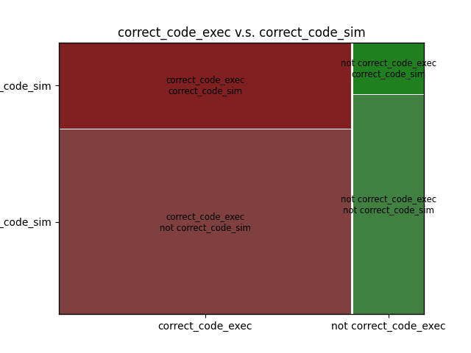
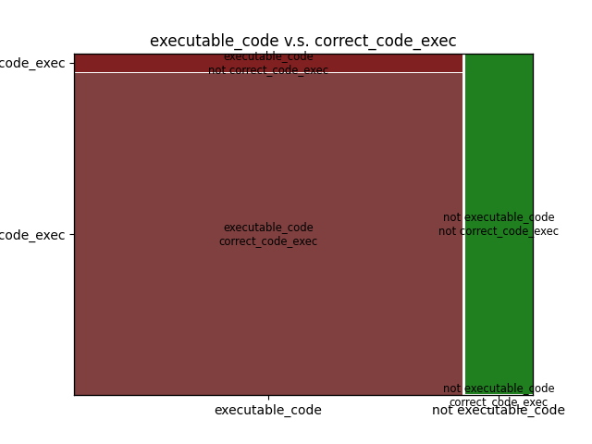
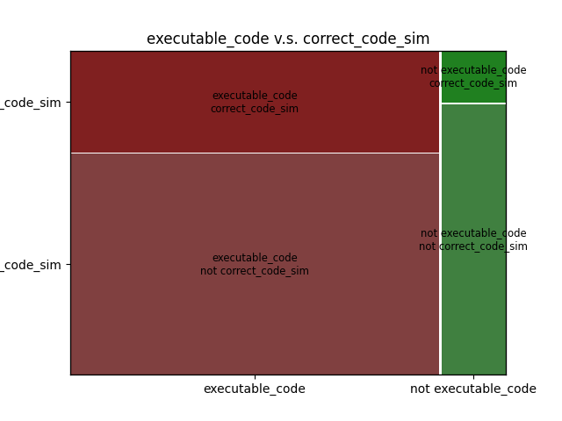
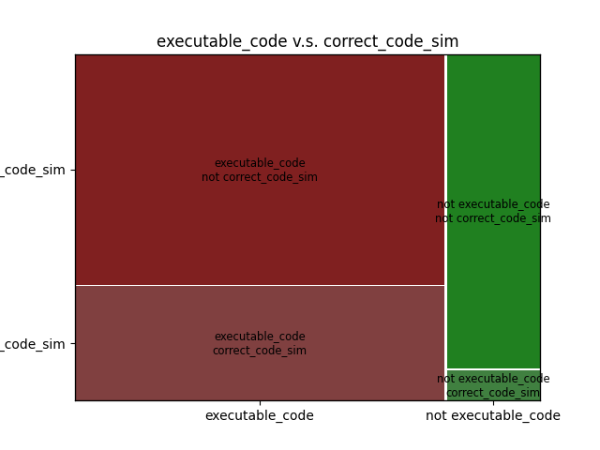
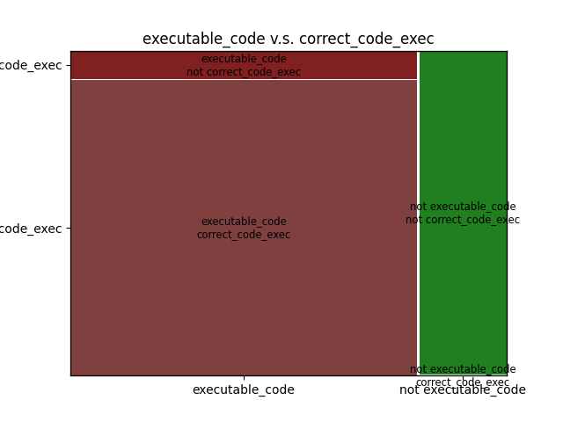




Recovery Rate Are Low
executable code exec vs exec
Executable code vs correct sim
Correct code exec vs sim
Deepseek
Gemma
Olmo

Slide 60
LLM Brain on ChatGPT
Agents continually learn w/ Tools
Individual performance Degradation?

